Slide 1
Automatic
Market
Maker (AMM)

Slide 2
Order book ?
As the name suggests, an order book lists all the buy/sell orders of a particular item.
A buy order is known as a bid while a sell order is known as an ask.
The order book maintains the numbers of items that are being asked or bid at a particular price point.
When the traders put their orders, the order book organizes them according to the price associated.
As a result, as long as there is a supply and demand, any trader can trade the asset.

Slide 3
The difference between the highest bid and the lowest ask is called the spread.
Markets with high liquidity have much smaller spreads, since the depth of demand and supply at each price level is high.

Slide 4
Pros -
Order book exchanges are ideal for liquid markets
Order book exchanges reduce the risk of slippage
Order book exchanges are widely accepted by both institutional and retail traders alike
Order book exchanges remain optimal for surfacing market prices and placing large orders

Slide 5
Cons -
An individual cannot trade if their highest bid is lower than the lowest ask, which presents a poor design for illiquid markets
he order book provides a list of bid and ask orders – clues about the price of a asset. Based on these clues, traders can predict the price direction of asset in a short term.
In order book trader have to pay high middle fees and charges.

Slide 6
Examples -
Polkadex
Mdex

Slide 7
What is AMM?
An automated market maker (AMM) is the underlying protocol of decentralized exchanges (DEXs)
AMM DEXs use a self-executing program, smart contract to define digital assets’ price and then provide liquidity.
On DEXs that use order book systems, P2P exchange development is used for trading transactions.
In contrast, AMM DEXs follow the concept of P2C (peer-to-contract) transactions because users do trading activities with the liquidity locked inside a Smart Contract.
That’s why Smart Contract can also be called a liquidity pool. In the AMM system, the price of tokens is determined by a formula.

Slide 8
You could think of an automated market maker as a robot that’s always willing to quote you a price between two assets.
Not only can you trade trustlessly using an AMM, but you can also become the house by providing liquidity to a liquidity pool.
This allows essentially anyone to become a market maker on an exchange and earn fees for providing liquidity.

Slide 9
An automated market maker (AMM) is a type of decentralized exchange (DEX) protocol that relies on a mathematical formula to price assets. Instead of using an order book like a traditional exchange, assets are priced according to a pricing algorithm.
This formula can vary with each protocol. For example, Uniswap uses x * y = k, where x is the amount of one token in the liquidity pool, and y is the amount of the other. In this formula, k is a fixed constant, meaning the pool’s total liquidity always has to remain the same. Other AMMs will use other formulas for the specific use cases they target. The similarity between all of them, however, is that they determine the prices algorithmically

Slide 10
Pros -
Automated and permission-less fast trading of digital assets dictated by smart contracts.
Users can trade against a pool of tokens without involving an intermediary.
Traders accomplish their trading without relying on a buyer as funds are locked in a smart contract.
Traders benefit from regular trading as they don’t require finding people willing to trade or match their desired price.
Incentivization for liquidity providers ensures the influx of assets in a pool, which helps increase the liquidity in the pool.

Slide 11
Cons -
AMM causes high slippage for large orders: Slippage relies on the liquidity pool’s size of a certain trading pair. In AMM DEXs, the larger the orders, the higher the slippage. For example, in Uniswap, an order size that accounts for half of the liquidity pool leads to a rise in the average price of the token, as twice the normal price. The liquidity pool needs to be 100x greater than the size of the order to keep the slippage rate under 1%.
Impermanent loss for liquidity providers: Several people misunderstand that Liquidity Providers in AMM DEXs earn a fixed income. However, the profits of LPs come from trading fees of traders in the liquidity pool and there is a huge risk for them, which is impermanent loss.

Slide 12
Example -
Uniswap
Balancer
Bancor
Curve
Hegic
Aave
Ox

Slide 13
Liquidity pool -
Liquidity providers (LPs) add funds to liquidity pools. You could think of a liquidity pool as a big pile of funds that traders can trade against.
In return for providing liquidity to the protocol, LPs earn fees from the trades that happen in their pool.
Why is attracting liquidity important? Due to the way AMMs work, the more liquidity there is in the pool, the less slippage large orders may incur. That, in turn, may attract more volume to the platform, and so on.

Slide 14
Slippage -
Slippage is when the price at which your order is executed does not match the price at which it was requested.
This most generally happens in fast moving, highly volatile markets which are susceptible to quick and unexpected turns in a specific trend.
The slippage issues will vary with different AMM designs, but it’s definitely something to keep in mind.
In a simplified way, it’s determined by how much the ratio between the tokens in the liquidity pool changes after a trade. If the ratio changes by a wide margin, there’s going to be a large amount of slippage.

Slide 15
impermanent loss -
Impermanent loss happens when the price ratio of deposited tokens changes after you deposited them in the pool.
The larger the change is, the bigger the impermanent loss.

Slide 16
Let’s go through an example of how impermanent loss may look like for a liquidity provider.
Alice deposits 1 ETH and 100 DAI in a liquidity pool. In this particular automated market maker (AMM), the deposited token pair needs to be of equivalent value. This means that the price of ETH is 100 DAI at the time of deposit. This also means that the dollar value of Alice’s deposit is 200 USD at the time of deposit.
In addition, there’s a total of 10 ETH and 1,000 DAI in the pool – funded by other LPs just like Alice. So, Alice has a 10% share of the pool. Let’s say that the price of ETH increases to 400 DAI. While this is happening, arbitrage traders will add DAI to the pool and remove ETH from it until the ratio reflects the current price.
AMMs don’t have order books. What determines the price of the assets in the pool is the ratio between them in the pool. While liquidity remains constant in the pool (10,000), the ratio of the assets in it changes. If ETH is now 400 DAI, the ratio between how much ETH and how much DAI is in the pool has changed. There is now 5 ETH and 2,000 DAI in the pool, thanks to the work of arbitrage traders.

Slide 17
So, Alice decides to withdraw her funds. As we know from earlier, she’s entitled to a 10% share of the pool. As a result, she can withdraw 0.5 ETH and 200 DAI, totaling 400 USD. She made some nice profits since her deposit of tokens worth 200 USD, right? But wait, what would have happened if she simply holds her 1 ETH and 100 DAI? The combined dollar value of these holdings would be 500 USD now. We can see that Alice would have been better off by HODLing rather than depositing into the liquidity pool. This is what we call impermanent loss. In this case, Alice’s loss wasn’t that substantial as the initial deposit was a relatively small amount. Keep in mind, however, that impermanent loss can lead to big losses (including a significant portion of the initial deposit).

Slide 18
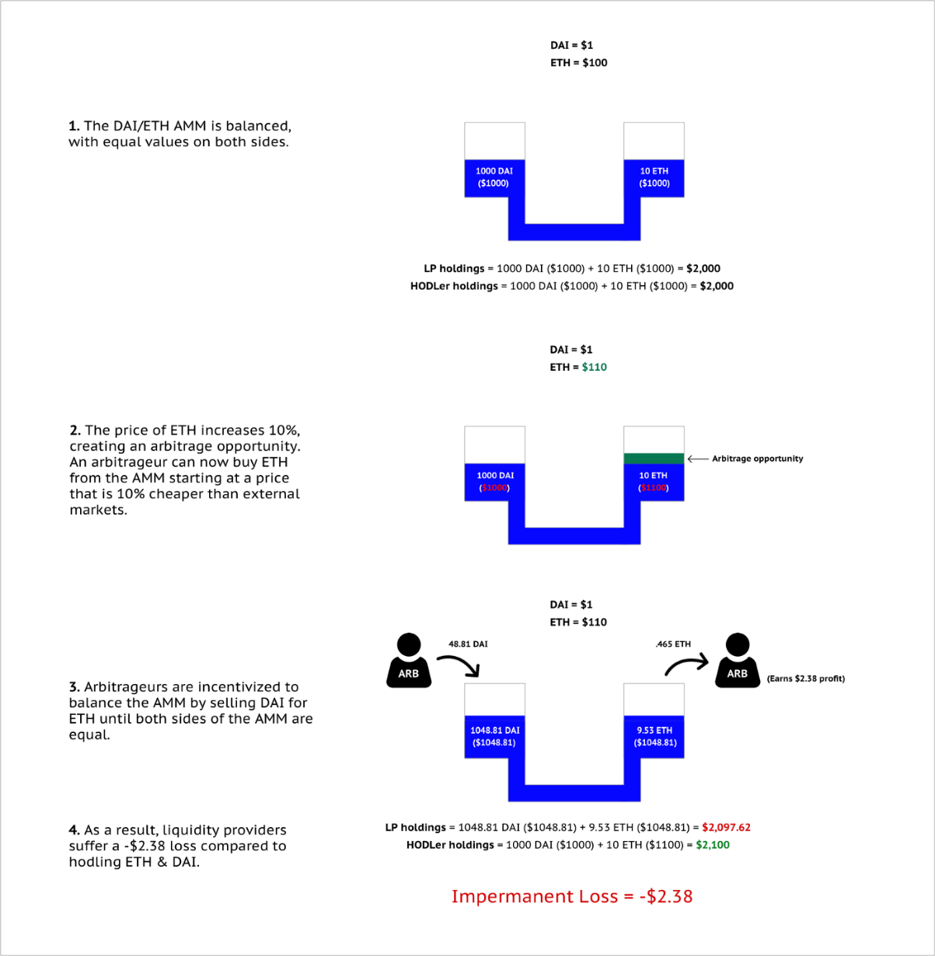

Slide 19
What Is Bancor?-
Bancor is a blockchain protocol that allows users to convert different virtual currency tokens directly and instantly instead of exchanging them on cryptocurrency exchanges like Coinbase
Bancor invented the world's first blockchain-based automated liquidity pool, or automated market maker (AMM) called a Smart Token, a digital currency with an embedded converter (smart contract) that allows it to be issued or exchanged automatically for any token in its network.

Slide 20
Bancor is a decentralized financial network that seeks to provide liquidity to small- and micro-cap coins and returns for liquidity providers.
Internally, the Bancor network uses the concept of Constant Reserve Ratio (CRR) in all smart token contracts, which purports to eliminate the possibility of the reserve value of smart tokens being depleted

Slide 21
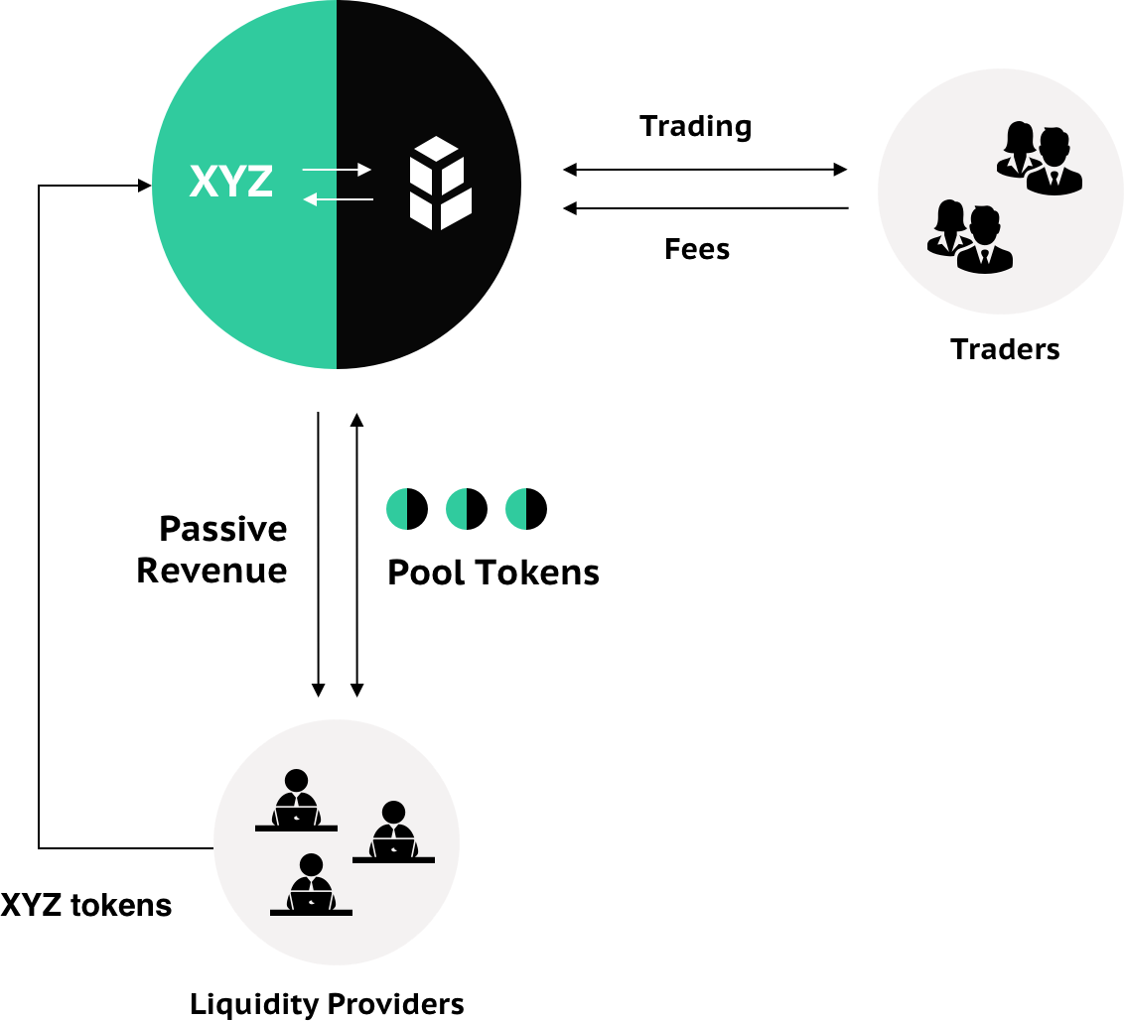

Slide 22
Unlike other AMMs like Uniswap or Balancer, Bancor uses its protocol token, BNT, as the counterpart asset in every pool
Bancor v2.1, BNT evolved into an elastic supply token. This new protocol functionality allows Bancor to offer two key features to AMM liquidity providers: single-asset exposure and impermanent loss insurance.

Slide 23
Uniswap -
Uniswap is a cryptocurrency exchange which uses a decentralized network protocol.
Uniswap uses Constant Product Market Maker (CPMM) to determine price.
Liquidity providers create a market by depositing an equivalent value of two tokens. These can either be ETH and an ERC-20 token or two ERC-20 tokens.
One of the most significant changes coming with Uniswap v3 relates to capital efficiency.
Liquidity providers can now set custom price ranges for which they want to provide liquidity for. This should lead to more concentrated liquidity in the price range that most trading activity happens in.

Slide 24
Balancer
Balancer extends 2-token pools of Uniswap V2 to multi-token pools. The value of each type of asset in a Balancer pool holds an invariant weight that adds up to 1.
The Balancer is a multi-token automated market-making protocol. It allows the platform users to swap tokens, add liquidity to an existing pool, and create a new pool.
Balancer also introduces the Smart Order Router (SOR⁹) algorithm.

Slide 25
Balancer Pool Creation Limitations
• Users can add a max of 8 tokens.
• The swap fee must be between 0.0001% and 10%.
• Pool tokens must be ERC20 compliant.
Types Of Balancer Pools
• Finalized/Public — The pool parameters (asset types, weights, and fees) are fixed, and anyone can add/remove liquidity and swap tokens.
• Controlled/Private — Controlled pools are solely managed by a “controller” address. Only this address can add or remove liquidity to the pool (call join or exit). The pool parameters are not fixed, i.e., the pool asset types and their weights can be changed.

Slide 26
Pros: Balancer generalizes 2-token pools to multi-token pools, and introduces the SOR algorithm to achieve better prices for its users.
Cons: “A liquidity pool is only as strong as its weakest asset.” The more types of tokens in one pool, the higher the risk.

Slide 27
Curve
Like Uniswap, Curve is a decentralized exchange for trading cryptocurrency assets
The key difference between them is that on Uniswap, you can swap any ERC-20 token (as long as there’s liquidity), whereas Curve is specifically for trading stablecoins on Ethereum.
Low trading fees — Curve offers traders far lower trading fees for stablecoin trades than Uniswap (0.3% per trade at Uniswap vs. 0.04% on Curve).
Minimized slippage — Whale traders and high-volume trading pairs are subject to slippage, but Curve’s similar asset pools minimize this.
No impermanent loss — Liquidity providers on Curve supply stablecoin pairs that nearly eliminate impermanent loss.

Slide 28
Curve merges Constant Sum Market Maker (CSMM) and Constant Product Market Maker (CPMM) together to achieve lower price slippage.
We can think of this algorithm as adding a constant price part to the Uniswap/Balancer model to make the resulting function pegged to a certain price.

